Slide 1

CSE- 321
Software Engineering
Lecture: 07 Software Processes
( part-03)
Fahad Ahmed
Lecturer, Dept. of CSE
E-mail: fahadahmed@uap-bd.edu

Slide 2
Lecture Outlines
Agile Model
Comparison of Various SDLC Models
Software Evolution
Rational Unified Process
Computer-Aided Software Engineering

Slide 3
Agile Model
Agile model is a combination of iterative and incremental process models with focus on process adaptability and customer satisfaction by rapid delivery of working software product.
This is where the agile software development comes to the rescue. It was specially designed to curate the needs of the rapidly changing environment by embracing the idea of incremental development and develop the actual final product.
Agile Methods break the product into small incremental builds. These builds are provided in iterations.
Every iteration involves cross functional teams working simultaneously on various areas like planning, requirements analysis, design, coding, unit testing, and acceptance testing.
At the end of the iteration a working product is displayed to the customer and important stakeholders.

Slide 4
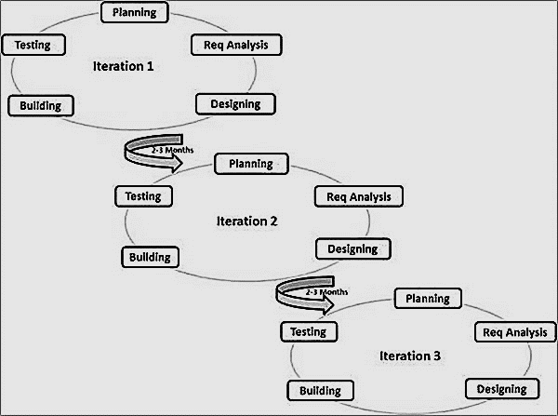
Agile Model
https://www.tutorialspoint.com/sdlc/sdlc_agile_model.htm

Slide 5
Agile Model
Agile model believes that every project needs to be handled differently and the existing methods need to be tailored to best suit the project requirements.
In agile the tasks are divided to time boxes (small time frames) to deliver specific features for a release.
Iterative approach is taken and working software build is delivered after each iteration. Each build is incremental in terms of features; the final build holds all the features required by the customer.

Slide 6
Agile Model
Agile Manifesto
The Agile Manifesto’s core statement says: – “We are uncovering better ways of developing software by doing it and helping others do it. Through this work, we have come to value:”
The agile software development emphasizes on four core values.
Individuals and interactions over processes and tools.
Working software over comprehensive documentation.
Customer collaboration over contract negotiation.
Responding to change over following a plan.
https://www.tutorialspoint.com/sdlc/sdlc_agile_model.htm

Slide 7
Agile Model : Case Study
A Software company named ABC wants to make a new web browser for the latest release of its operating system. The deadline for the task is 10 months. The company’s head assigned two teams named Team A and Team B for this task.
In order to motivate the teams, the company head says that the first team to develop the browser would be given a salary hike and a one week full sponsored travel plan.
The team A decided to play by the book and decided to choose the Waterfall model for the development. Team B after a heavy discussion decided to take a leap of faith and choose Agile as their development model.

Slide 8
Agile Model : Case Study
In traditional Waterfall model –
At a high level, the project teams would spend 15% of their time on gathering requirements and analysis (1.5 months)
20% of their time on design (2 months)
40% on coding (4 months) and unit testing
20% on System and Integration testing (2 months).
At the end of this cycle, the project may also have 2 weeks of User Acceptance testing by marketing teams.
In this approach, the customer does not get to see the end product until the end of the project, when it becomes too late to make significant changes.
.

Slide 9
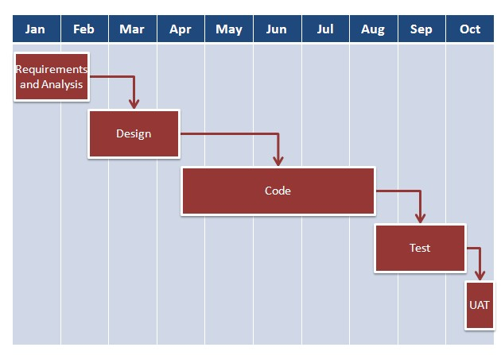
Agile Model : Case Study
The image below shows how these activities align with the project schedule in traditional software development.

Slide 10
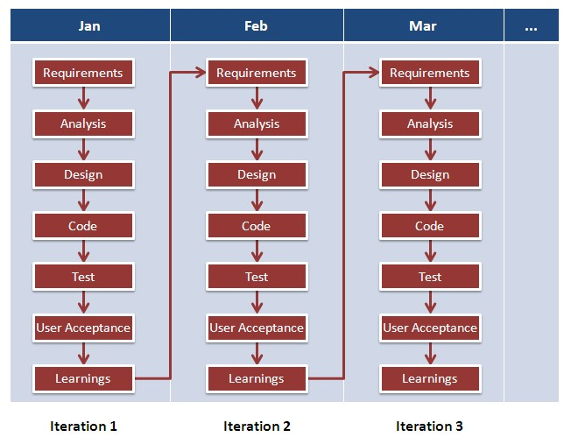
Agile Model : Case Study

Slide 11
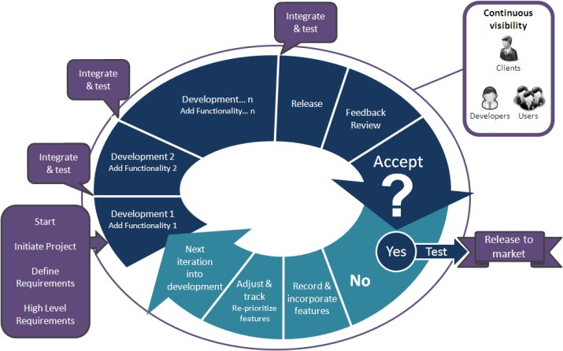
Agile Model : Case Study

Slide 12
Agile Model : Case Study
With Agile development methodology –
In the Agile methodology, each project is broken up into several ‘Iterations’.
All Iterations should be of the same time duration (between 2 to 8 weeks).
At the end of each iteration, a working product should be delivered.
In simple terms, in the Agile approach the project will be broken up into 10 releases (assuming each iteration is set to last 4 weeks).
Rather than spending 1.5 months on requirements gathering, in Agile software development, the team will decide the basic core features that are required in the product and decide which of these features can be developed in the first iteration.
Any remaining features that cannot be delivered in the first iteration will be taken up in the next iteration or subsequent iterations, based on priority.
At the end of the first iterations, the team will deliver a working software with the features that were finalized for that iteration.

Slide 13
Agile Model : Case Study
There will be 10 iterations and at the end of each iteration the customer is delivered a working software that is incrementally enhanced and updated with the features that were shortlisted for that iteration
This approach allows the customer to interact and work with functioning software at the end of each iteration and provide feedback on it. This approach allows teams to take up changes more easily and make course corrections if needed. In the Agile approach, software is developed and released incrementally in the iterations.
Agile development has become common place in IT industry.
In a recent survey over 52% of respondents said that their company practiced Agile development in one form or another.

Slide 14
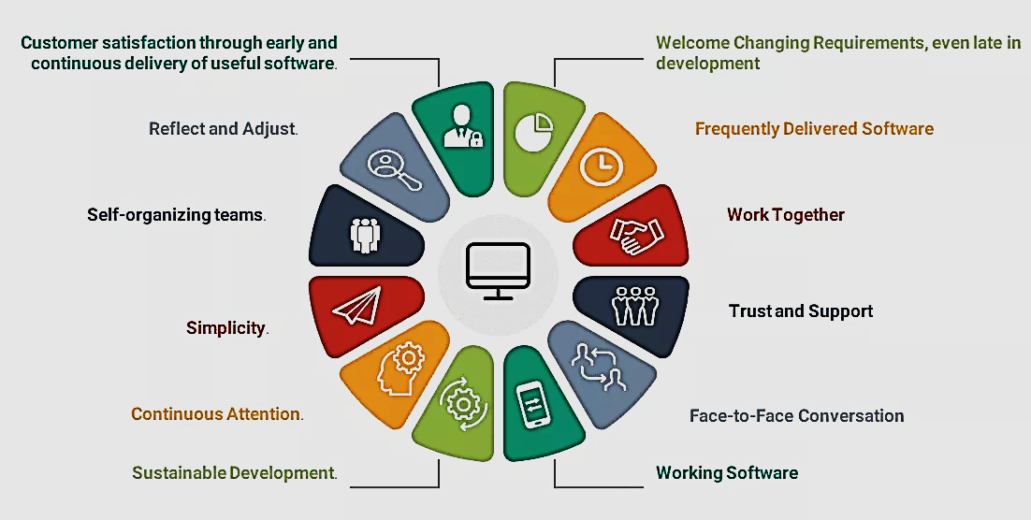
Agile Model
Principles of Agile model:
https://www.toolsqa.com/agile/agile-methodology/

Slide 15
Agile Model
Principles of Agile model:
Our highest priority is to satisfy the customer through early and continuous delivery of valuable software.
Welcome changing requirements, even late in development. Agile processes harness change for the customer's competitive advantage.
Deliver working software frequently, from a couple of weeks to a couple of months, with a preference to the shorter timescale.
Business people and developers must work together daily throughout the project.
Build projects around motivated individuals. Give them the environment and support they need, and trust them to get the job done.
The most efficient and effective method of conveying information to and within a development team is face–to–face conversation.

Slide 16
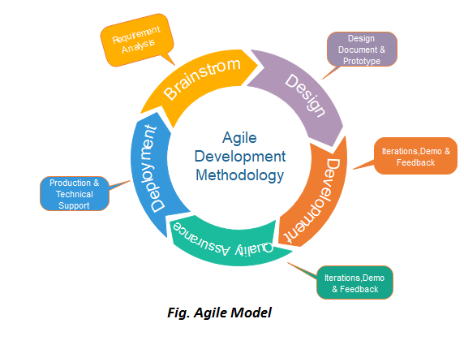
Agile Model
Phases of Agile Model:
Following are the phases in the Agile model are as follows:
Requirements gathering
Design the requirements
Construction/ iteration
Testing/ Quality assurance
Deployment
Feedback

Slide 17
Agile Model
Agile Frameworks:
Scrum
Crystal
Dynamic Software Development Method(DSDM)
Feature Driven Development(FDD)
eXtreme Programming(XP)
https://www.javatpoint.com/software-engineering-agile-model

Slide 18
Agile Model
What is Scrum?
Scrum is one of the most commonly used Agile methodologies. Scrums have gained popularity within the Agile software development community because they are simple and have a proven productivity rate.
Scrum focuses on Team. It is a method that concentrates specifically on how to manage tasks within a team-based development environment. Scrum believes in enabling & empowering the development team and suggests working in small teams (say- 7 to 9 members).

Slide 19
Agile Model
Principle of Scrum
The fundamental principle of Scrum is that by dividing time and projects, you can enhance an organization’s effectiveness and productivity.
Scrum makes the process of development less complicated by making the information transparent.
There are three roles in it, and their responsibilities are:
Scrum Master: The scrum can set up the master team, arrange the meeting and remove obstacles for the process
Product owner: The product owner makes the product backlog, prioritizes the delay and is responsible for the distribution of functionality on each repetition.
Scrum Team: The team manages its work and organizes the work to complete the sprint or cycle.

Slide 20
Agile Model
Process flow of Scrum Methodologies:
Process flow of scrum testing is as follows:
Each iteration of a scrum is known as Sprint
Product backlog is a list where all details are entered to get the end-product
During each Sprint, top user stories of Product backlog are selected and turned into Sprint backlog
Team works on the defined sprint backlog
Team checks for the daily work
At the end of the sprint, team delivers product functionality

Slide 21
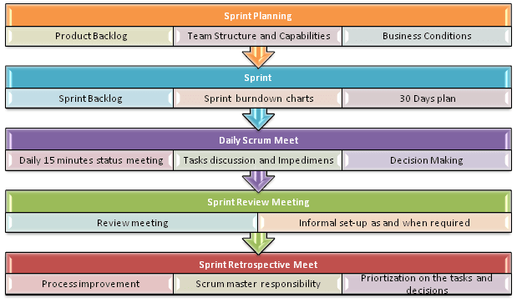
Agile Model
Process flow of Scrum Methodologies:

Slide 22
eXtreme Programming (XP)
eXtreme Programming (XP):
Extreme programming (XP) is a Software Development Methodology which is intended to improve software quality and responsiveness to changing customer requirements.
XP is a lightweight, efficient, low-risk, flexible, predictable, scientific, and fun way to develop a software.
XP is the most specific of the agile frameworks regarding appropriate engineering practices for software development.

Slide 23
eXtreme Programming (XP)
eXtreme Programming (XP):
Extreme Programming technique is very helpful when there is constantly changing demands or requirements from the customers or when they are not sure about the functionality of the system.
It advocates frequent "releases" of the product in short development cycles, which inherently improves the productivity of the system and also introduces a checkpoint where any customer requirements can be easily implemented. The XP develops software keeping customer in the target.

Slide 24
eXtreme Programming (XP)
Why is it called “eXtreme”?
eXtreme Programming takes the effective principles and practices to extreme levels.
Code reviews are effective as the code is reviewed all the time.
Testing is effective as there is continuous regression and testing.
Design is effective as everybody needs to do refactoring daily.
Integration testing is important as integrate and test several times a day.
Short iterations are effective as the planning game for release planning and iteration planning.

Slide 25
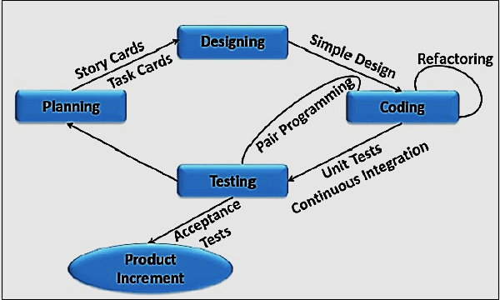
eXtreme Programming (XP)

Slide 26
When to use Agile and Non-Agile models
Project Attributes | Agile Model | Non-Agile Model
Requirement of the Project | Requirements in Agile model can change as per the customer requirement. Sometimes requirements are not very clear. | In Non-Agile models the requirements are very clear before entering into the development phases. Any change in the requirement is not easily accepted during the development phases.
Size of the Project | The Project size is small in Agile model hence small team is required. | But in Non-Agile models the Project size is usually big hence big team is required.
Design of the Project | In Agile model the architecture is made as per the current requirements but is designed to be flexible. | In Non-Agile models the architecture is made as per the current requirements as well as for future requirements.
Type of Customers | Agile methodology is followed by the collaborated, dedicated collated and knowledgeable customers. | In Non-Agile models the customers are of Contract provisions.
Developers required | In Agile model the developers should be knowledgeable, analytically strong, collated and collaborative. | In Non-Agile models the developers should be more Plan Oriented.

Slide 27
Agile Model
Advantage :
Frequent Delivery
Face-to-Face Communication with clients.
Efficient design and fulfils the business requirement.
Anytime changes are acceptable.
It reduces total development time.
Disadvantages :
Depends heavily on customer interaction, so if customer is not clear, team can be driven in the wrong direction.
There is a very high individual dependency, since there is minimum documentation generated.
Transfer of technology to new team members may be quite challenging due to lack of documentation.

Slide 28
Difference between Agile and Waterfall Model
Key Difference
Waterfall is a Liner Sequential Life Cycle Model whereas Agile is a continuous iteration of development and testing in the software development process.
Agile methodology is known for its flexibility whereas Waterfall is a structured software development methodology.
Agile follows an incremental approach whereas the Waterfall methodology is a sequential design process.
Agile performs testing concurrently with software development whereas in Waterfall methodology testing comes after the “Build” phase.
Agile allows changes in project development requirement whereas Waterfall has no scope of changing the requirements once the project development starts.

Slide 29
Comparison of Various SDLC Models
Properties of Model | Water-Fall Model | Incremental Model | Spiral Model | Rad Model
Planning in early stage | Yes | Yes | Yes | No
Returning to an earlier phase | No | Yes | Yes | Yes
Handle Large-Project | Not Appropriate | Not Appropriate | Appropriate | Not Appropriate
Detailed Documentation | Necessary | Yes but not much | Yes | Limited
Cost | Low | Low | Expensive | Low
Requirement Specifications | Beginning | Beginning | Beginning | Time boxed release
Flexibility to change | Difficult | Easy | Easy | Easy
User Involvement | Only at beginning | Intermediate | High | Only at the beginning
Maintenance | Least | Promotes Maintainability | Typical | Easily Maintained
Testing | After completion of coding phase | After every iteration | At the end of the engineering phase | After completion of coding
Overlapping Phases | No | Yes | No | Yes
Re-usability | Least possible | To some extent | To some extent | Yes
Working software availability | At the end of the life-cycle | At the end of every iteration | At the end of every iteration | At the end of the life cycle
Objective | High Assurance | Rapid Development | High Assurance | Rapid development
Team size | Large Team | Not Large Team | Large Team | Small Team
Customer control over administrator | Very Low | Yes | Yes | Yes

Slide 30
Software Evolution
Software evolution is concerned with modifying existing software systems to meet new requirements. This is becoming the normal approach to software development for small and medium-sized systems.

Slide 31
Rational Unified Process
The Rational Unified Process (RUP) is an example of a modern process model derived from the work on the UML and associated process.
Normally described from 3 perspectives
A dynamic perspective that shows phases over time;
A static perspective that shows process activities;
A practice perspective that suggests good practice.

Slide 32
RUP phases
Inception
Establish the business case for the system.
Elaboration
Develop an understanding of the problem domain and the system architecture.
Construction
System design, programming and testing.
Transition
Deploy the system in its operating environment.

Slide 33
Rational Unified Process
Six fundamental best practices are recommended:
Develop software iteratively
Manage requirements
Use component-based architectures
Visually model software
Verify software quality
Control changes to software

Slide 34
Computer-Aided Software Engineering
Computer-Aided Software Engineering (CASE) is software to support software development and evolution processes.
Activity automation
Graphical editors for system model development;
Data dictionary to manage design entities;
Graphical UI builder for user interface construction;
Debuggers to support program fault finding;
Automated translators to generate new versions of a program.

Slide 35
Computer-Aided Software Engineering
CASE classification
Classification helps us understand the different types of CASE tools and their support for process activities.
Functional perspective
Tools are classified according to their specific function.
Process perspective
Tools are classified according to process activities that are supported.
Integration perspective
Tools are classified according to their organisation into integrated units.

Slide 36
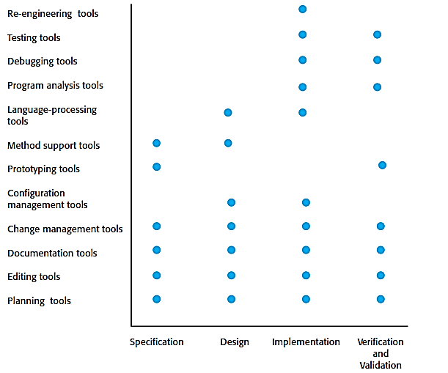
Activity Based Classification of CASE Tools

Slide 37
CASE Integration
Tools
Support individual process tasks such as design consistency checking, text editing, etc.
Workbenches
Support a process phase such as specification or design, Normally include a number of integrated tools.
Environments
Support all or a substantial part of an entire software process. Normally include several integrated workbenches.

Slide 38
CASE Integration

Slide 39

Thanks to All

